Slide 1
Dutch Disease in Eastern Mediterranean
Grigoris Zarotiadis, Dr. Assoc. Professor
Dean of the Faculty of Economic and Political Sciences, AUTh
President of ASECU
gzarotia@econ.auth.gr

Slide 2
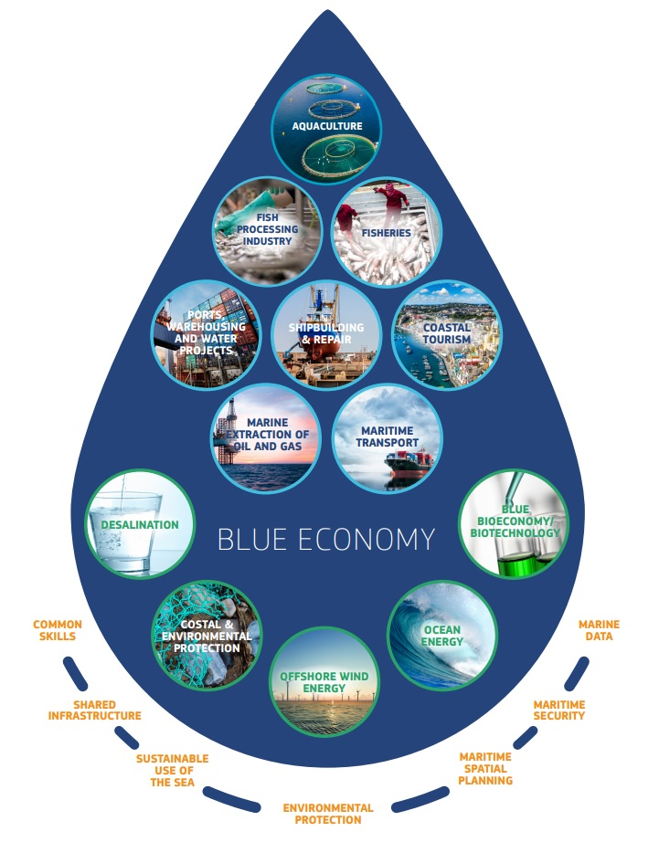
Motivation and Introductory Notes
The two interrelated dimensions of Sustainability:
Socioeconomic and
Environmental
Market Failures
IRS and inhomogeneity for monopolization
Imperfect Information and Externalities
Blue Economy:
(Sea related) Tourism; Transportation; Fisheries; Coastal Activities; R&D; Energy.
… what about sustainability?
Mediterranean Blue Economy
5th Economy of Europe
1/5 of Global Blue Economy Output
Relevant Initiatives of the EC

Slide 3
Standard Dutch Disease
Dutch Disease: a case of macro-externality
The term originated in the Netherlands during the 1960s, when the high revenue generated by its natural gas discovery led to a sharp decline in the competitiveness of its other, non-booming tradable sector.
Basic Definition: the increase in the economic development of a specific sector (for example natural resources) induces a decline in other sectors. In other a crowding-out case.
Supposed mechanism: as revenues increase in the growing (export oriented) sector, domestic currency (e) and inflation appreciates (p) (manifest in real exchange rate).
Adverse distributional effects, in social and spatial dimension.
Stagnation, even decrease of employment economy wide.
Adverse long run growth effect, especially in case of drilling economy.
T (p*e)
slope≈ p / p*e
slope≈ p / p*e
NT (p)

Slide 4
Dutch Disease ala Mediterranean (1)
Widening the mechanism:
(i) Opportunity costs.
(ii) The significance of consumer preferences.
(iii) World prices (p*) may fall.
Mediterranean version:
Economic effect
Inflationary pressures (less, yet still possible a combined exchange rate effect).
Environmental effect
(i) Direct “cleaning” costs
(ii) Opportunity costs for other sectors – environmental crowding out
(iii) Non-financial effects
Geopolitical effect
(i) Direct “dealing” costs
(ii) Opportunity costs for other sectors – geopolitical crowding out
(iii) Non-financial effects.
T (p*e)
slope≈ p / p*e
slope≈ p / p*e
NT (p)

Slide 5
To drill or not to drill?
Economic impacts of the exploitation of hydrocarbons in Greece - An analysis for World Wide Fund for Nature (WWF) Greece, January 2019
Table ES. 1: Economic costs over 25-year period to different regions
Scenarios 1 to 3 Scenario 4
Eastern Macedonia and Thrace €5 million - €8 million €190 million
Crete €218 million - €304 million €2,161 million
Epirus €52 million - €81 million €218 million
Ionian Islands €513 million - €735 million €1,784 million
Peloponnese €48 million - €75 million €283 million
Western Greece €36 million - €57 million €161 million
Central Macedonia €11 million - €16 million €1,147 million
TOTAL €883 million – €1,275 million €5,943 million
Note: The costs shown above are presented in 2017 prices and have been calculated using a 4% discount rate.

Slide 6
To drill or not to drill?
Job to be done:
Include “environmental crowding out”
Include “economic (standard) crowding out”
Include direct “dealing” costs
Include “geopolitical crowding out”
Improve the set up of scenarios and the calculation of benefits
Duplicate the cost-benefit analysis for each Eastern Mediterranean country and summarize the results for the whole region.
… do not forget the “non-financial” effects.

